Slide 1
Product Owner Training
BADS Agile Project Delivery Process
December, 2018
Nancy M. Ketchum, PMP, CSM

Slide 2

Goals of New Project Delivery Process
To quickly and collaboratively deliver functioning software to our customers that supports their highest value business needs.
Collaborative & Transparent
Focused on Business Need
Iterative & Incremental
Flexible Plans

Slide 3
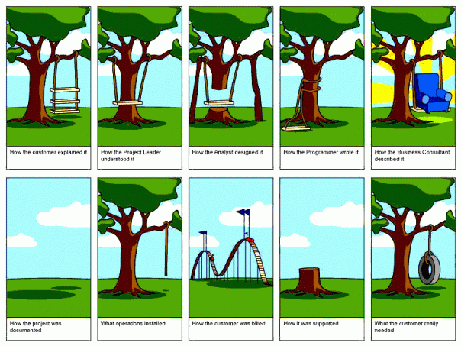

Slide 4

Project or Product?
Project Management Institute defines Project as:
A temporary endeavor undertaken to create a unique product, service, or result.
Projects have a beginning and an end
A Product is the result or end goal of the Project
Products can be used for an undetermined amount of time after the Projects that created them are complete.

Slide 5
New Terms
User Story – Defines requirements from the end User of the software’s point of view. Work is best done in time-boxed iterations (design, coding and testing all in the same iteration).
Epic – A large or undefined requirement that cannot be sized because it is too large and must be broken down.
Acceptance Criteria – Detailed outline of how to know a User Story is “Done”.
Product Backlog – The list of all known User Stories, Bugs, and Technical Tasks that could be worked into a product.
Sprint – A time-boxed iteration of work usually 2-4 weeks.
Spike – A unit of research work that is normally timeboxed so the team can control how much time they invest.
Technical Task – An item of work that the team must do in order to be in a position to act upon later User Stories.

Slide 6
New Terms
Impediment – An issue or any situation that is hindering the work being completed.
Priority – How important an item is to the business.
MoSCoW – A method for defining Priority.
Must have
Should have
Could have
Would like
Force Rank – Order of all items in Product Backlog where there is one and only one #1, one and only one #2, etc.
Story Points – Relative sizing mechanism that allows team to estimate quickly and manage scope with changing priorities.
Burndown Chart – Shows how team is doing toward its Sprint commitments.

Slide 7
Product Ownership
BADS Project Delivery Process

Slide 8
What does it mean to be a Product Owner?
Main decision maker for the Project and resulting Product
Project Team’s customer
Commonly a lead user of the system with a solid understanding of the business area
Has a vision for what is to be built into the Product
Develops requirements (User Stories)
Prioritizes the list of User Stories (Product Backlog)
Product Owners drive WHAT is to be done. The Project Team drives When and How it is to be done.
Actively engaged with the Project Team
Communicates with key stakeholders throughout the organization

Slide 9
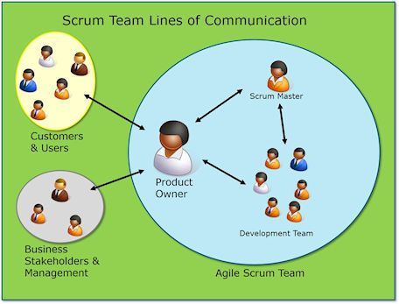
Who will I work with?
Romanpichler.com
Product Owners synthesize input from other Business Subject Matter Experts (SME) to understand what the Business area needs and its priorities.
ScrumMasters facilitate the working of the Project Team.

Slide 10
ScrumMaster vs. Project Manager
ScrumMaster:
Serves the Product Owner
Project Team facilitator for all ceremonies
Coach for Team and all Stakeholders on how to use the process to efficiently deliver the Project vision and goals
Removes impediments
Demonstrates impact to plans when changes are made
Project Manager:
High-level planning
Budgeting
Standard reporting to EPMO, Management, etc.

Slide 11
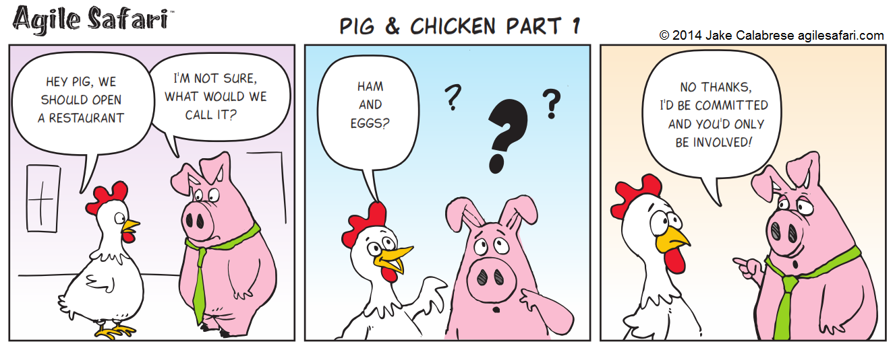
Are you a pig or a chicken?
Romanpichler.com

Slide 12
BADS Project Delivery Process

Slide 13




High Level BADS Process
Project Planning & Requirements
Development Sprints
Release Activities

Slide 14
High Level BADS Process
Project Planning & Requirements
Development Sprints
Release Activities

Slide 15
Project Planning & Requirements
Product Owner Responsibilities
Product Owner is responsible for defining User Stories, Acceptance Criteria, Priority, and Force Ranking for all Backlog Items in scope for the project.
May include other Business Subject Matter Experts
Requirements Gathering Sessions
Several 2-hour sessions at the very beginning of the Project
Planning Kick Off – approx. 1 hour
Project Delivery Kick Off – approx. 1 hour
Product Owner is the host for this meeting

Slide 16
Project Planning & Requirements
Key Deliverables
Agreed Upon Scope for Project
Think of it as a contract between the Product Owner and the Team
Defined in terms of number of Story Points (Not Stories)
Allows Product Owner to substitute newly uncovered higher priority work for items initially defined
Roles & Responsibilities
Defines all Roles needing to be filled for the Project to be successful
Outlines the expectations that role needs to fulfill (responsibilities)
Named person to fulfill each role
Estimated amount of time needed from that role/person
Release Plan
Sprints and Releases planned through completion of project
List of tentative items in each Sprint
Projected Release Burndown

Slide 18
High Level BADS Process
Project Planning & Requirements
Development Sprints
Release Activities

Slide 19
Development Sprints
Product Owner Responsibilities
Sprint Planning Meeting – Approx. 1.5 hours each Sprint
Works with team to ensure pre-planned sprint items are understood
Sprint Items are removed if Acceptance Criteria is not complete
Grooms Backlog Items – Approx. 1.5 hours each Sprint
Ensures next two Sprints are clearly defined
Priorities, Acceptance Criteria
Answers Ad Hoc Questions from Team
DevOps Tool - NO Emails
Represents Users at Sprint Review – Approx. 1.5 hours each Sprint
Accepts/Rejects as complete items demonstrated as working
May spin off new User Stories or Bugs

Slide 20
Development Sprints
Daily Standups?
15 minute Team Meeting
What I did since last Standup?
What I commit to completing by next Standup?
Impediments I have encountered?
Has my work gotten larger or smaller?
NOTHING else
Product Owner attends only at Team’s Request
New teams may need space
Brevity maintains focus on the work
Impediments are worked outside of the Standup
ScrumMaster will bring Impediments to Product Owner when needed

Slide 21
Development Sprints
Key Deliverables
Working Software
In QA Environment
Demonstrated as working per the Acceptance Criteria
Impediments Identified Early
ScrumMaster responsible for removing Impediments
Sprint Burndown
Hours Planned Burn vs. Capacity of Team vs. Actual Burn
Updated Release Burndown
Per Priority, # of Story Points Remaining vs. Projected
Team Velocity
Average # of Story Points the team has accomplished in completed sprints

Slide 23
High Level BADS Process
Project Planning & Requirements
Development Sprints
Release Activities

Slide 24
Release Activities
Product Owner Responsibilities
User Acceptance Testing
Uses original User Story Acceptance Criteria to test
Defines steps to reproduce any Bugs found
Only Critical and High Bugs are addressed
May utilize Business Subject Matter Experts
Signs off on User Acceptance Test
Production Validation
Is not meant to be another UAT
Ensures that all items got deployed
Signs off on Production Deployment

Slide 25
Release Activities
Key Deliverables
Working Software
In Production Environment
User Tested as working per Acceptance in QA
User Validated as existing in Production Environment
Updated Release Burndown
Any new User Stories or Bugs identified

Slide 27
Defining User Stories
How we know what you need

Slide 28
User Stories
Written from the User’s Point of View
Prioritized in the backlog by business value by Product Owner
Encourages conversations
Generate common understanding
Determine what needs to be done
Agreement on the definition of “done”
Must fit within a sprint; if not, break into smaller stories.
Exchangable by story point values
Understood by the whole team
NOT technical specifications

Slide 29
Format of a User Story
Who: As a <type of user>
What/Functionality: I want <to do something>
Why: So that <so value is created>

Slide 30
Examples of a User Story
As a member of the HRTS HCM Cloud team I need to update the security rules that drive row level security in the Fusion Application, so that I can easily respond to changes in security definitions that are requested by the Divisions.
As a CIS Portfolio Owner, I need a report that shows both the Project Fiscal Budget AND the Last Approved budget compared to the Project's Current Estimate at Completion (EAC) so that I can understand the financial status of projects for which I am responsible.
As Manager of Expense Programs, I would like an optimization report so that I can find new ways to better manage expenses across the organization
As the RC Leadership, I need a utilization dashboard so that I can better manage the schedules and work for Recruitment Coordinators.
As an Airline Customer I want the ability to purchase airplane tickets online, so that I do not have to call into the 800#.

Slide 31
User Story Format Variations
Goal Focused:
In order to <achieve some goal> as a <type of user>, I want <to do something>.
Value Focused:
In order to <create some value> as a <type of user>, I want <to do something>.

Slide 32
Acceptance Criteria
Definition of ‘DONE’
Comes after a common understanding of the User Story is reached
Product owner should write the acceptance criteria
A list of pass/fail tests.
If all tests pass → everyone agrees the story is implemented as intended.
Does not change during a sprint.

Slide 33
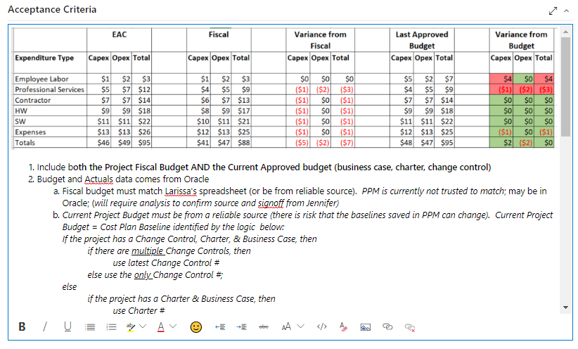
Example Acceptance Criteria

Slide 34
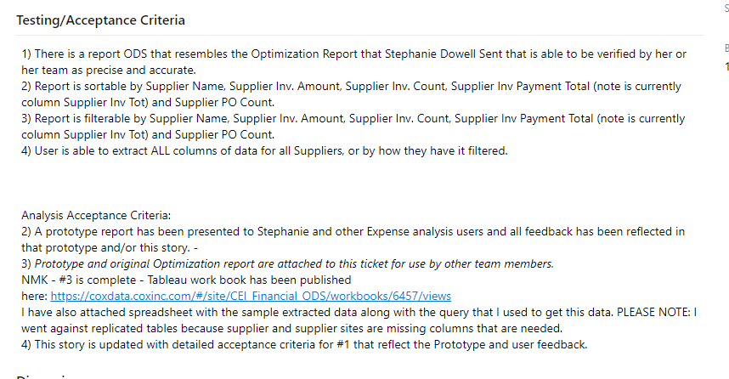
Example Acceptance Criteria

Slide 35
The Azure DevOps Tool
How we manage the Process

Slide 36
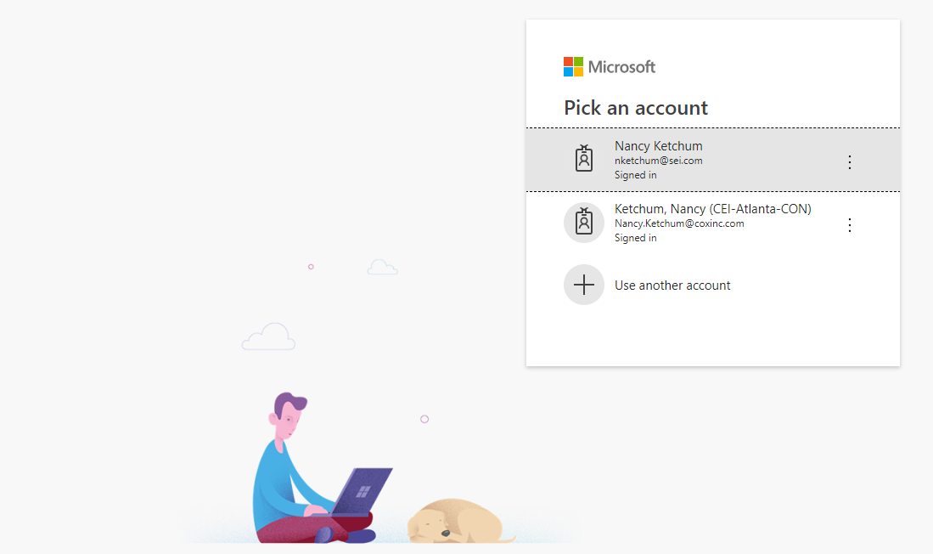
Azure DevOps Tool for the BADS Team
Visit the CEI-BADS Azure DevOps Organization:
https://dev.azure.com/CEI-BADS/
You may receive the following the first time you access the tool:
Select your Coxinc Microsoft Account
If you do not have one, contact Dan Murphy

Slide 37
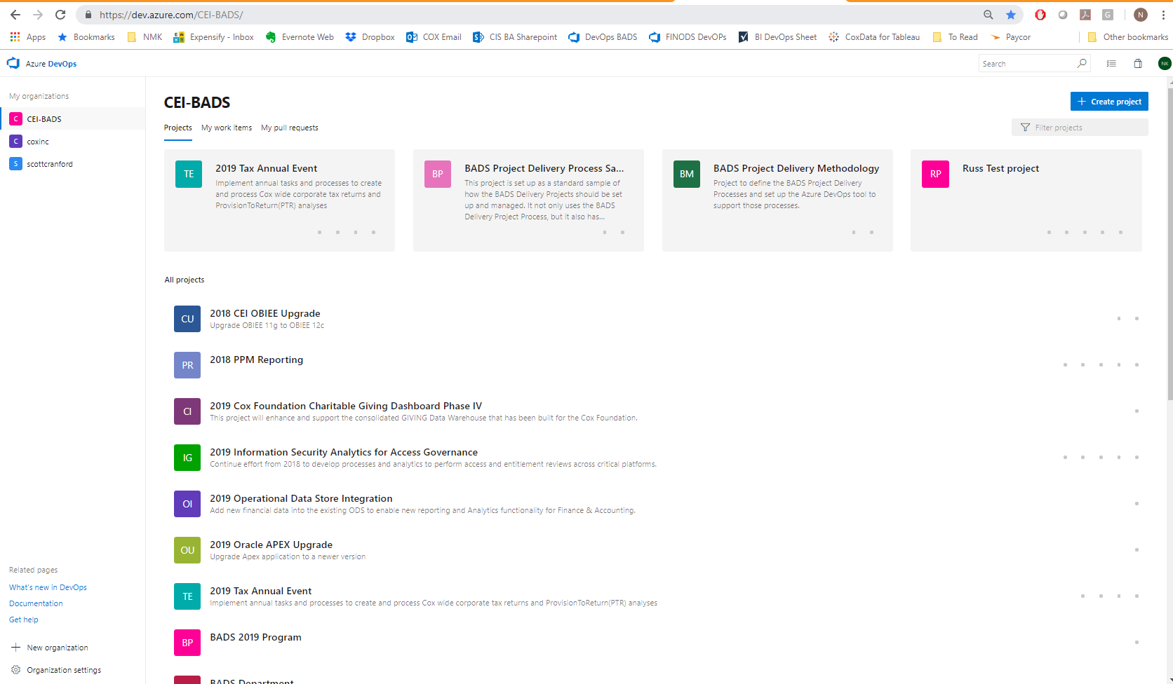
Azure DevOps Tool for the BADS Team
You want to end up here
Select the Project you are working on.

Slide 38
DevOps Product Owner Need to Know
How to write User Stories in DevOps?
Backlog Board
New Item
Types
Fields on a User Story
Where and how to Groom Backlog?
Backlog Board
Planning View
Priority
Force Rank

Slide 39
DevOps Product Owner Need to Know
How do I know what is planned for a Sprint?
Backlog Board, Planning View
Backlog Board, filter on Iteration
How do I add a new Item to a Sprint?
DON’T add items to Active Sprint (this will cause issues for Scrum Master)
Work with ScrumMaster
Trade something out

Slide 40
DevOps Product Owner Need to Know
Where do I find the Sprint Burndown?
Sprint Board
Reading the Sprint Burndown
Where does the Team Work from?
Sprint Board
By Story
By Assignee

Slide 41
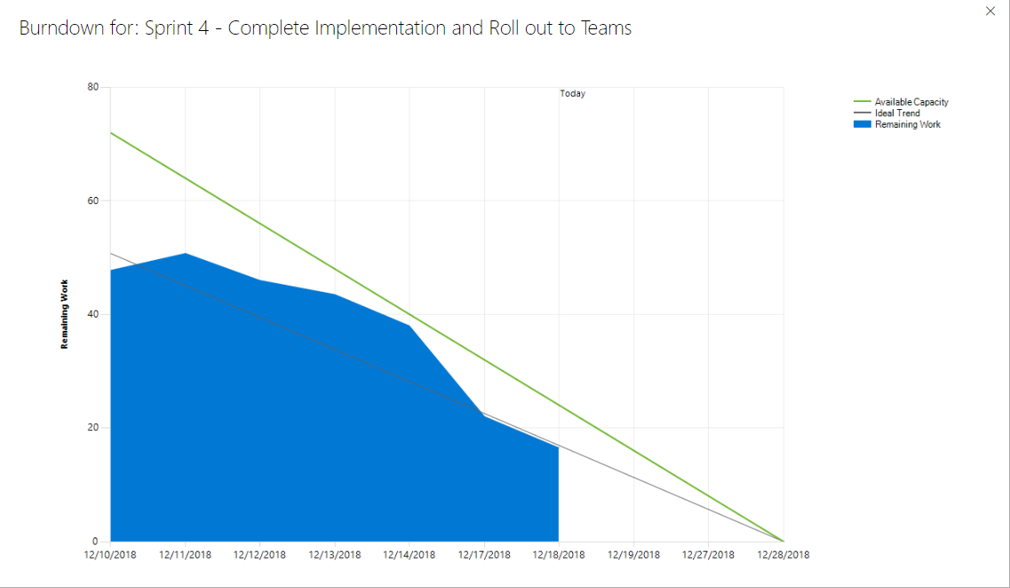
Reading a Sprint Burndown

Slide 42
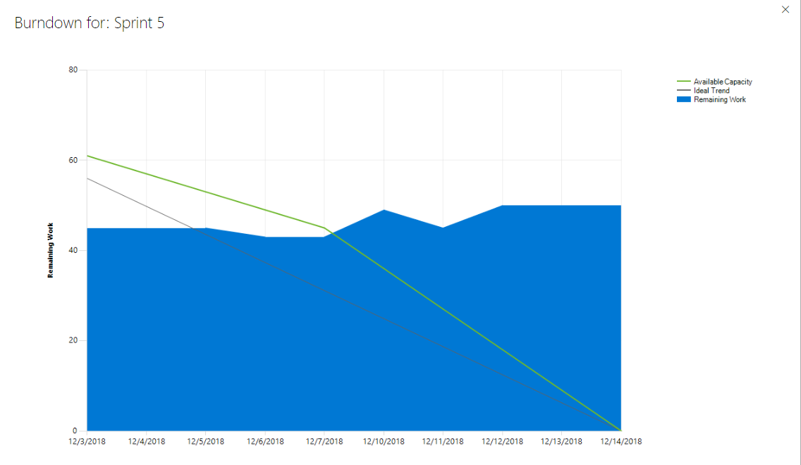
Reading a Sprint Burndown

Slide 43
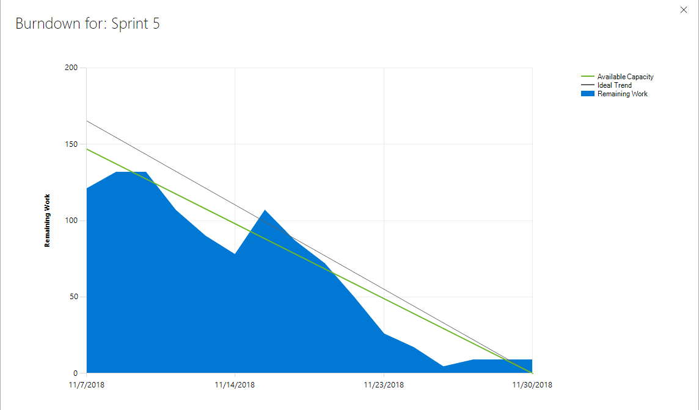
Reading a Sprint Burndown

Slide 44
DevOps Product Owner Need to Know
How do I communicate with the team?
@Mentions
NO MORE Emails
What about Status Reports?
Sprint Burndown
Release Plans
Release Burndown
ScrumMaster demonstrates Impacts to Changes – Stories that fall off the last Sprint

Slide 45
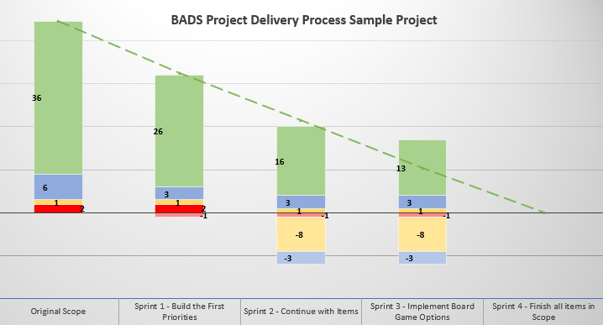
Reading a Release Burndown

Slide 46
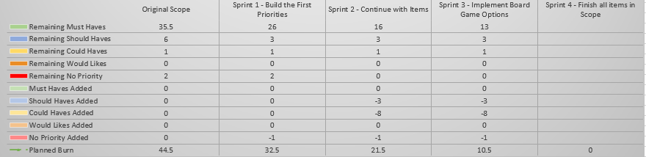
Reading a Release Burndown

Slide 47
ADDENDUM: Agile Framework
BADS Project Delivery Process
The BADS Project Delivery Process is based on the Agile Framework.

Slide 48

What is Agile?
Agile software development is a group of software development methods based on iterative and incremental development, where requirements and solutions evolve through collaboration between self-organizing, cross-functional teams. It promotes adaptive planning, evolutionary development and delivery, a time-boxed iterative approach, and encourages rapid and flexible response to change. It is a conceptual framework that promotes foreseen interactions throughout the development cycle. The Agile Manifesto introduced the term in 2001.¹

Slide 49
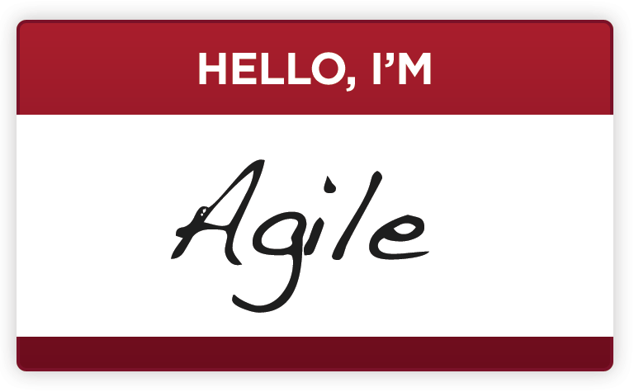
Agile is:
Iterative & Incremental
Work is best done in time-boxed iterations (design, coding and testing all in the same iteration)
Collaborative & Transparent
Requirements evolve through discussions
Delivers Value Often
React to rapidly changing conditions through short release cycles
Focused on Business / End User Needs
Product Owner Drives
Understand “business value” of features
Adaptive Planning
New requirements are incorporated in follow-on sprints along the way
Rapid & Flexible Response to Change

Slide 50

Agile is:
We are uncovering better ways of developing software by doing it and helping others do it. Through this work we have come to value:
Individuals and interactions over processes and tools
Working Software over comprehensive documentation
Customer collaboration over contract negotiation
Responding to change over following a plan
Requirements evolve through discussions between the Users and the Team
That is, while there is value in the items on the right, we value the items on the left more.
Agile Manifesto

Slide 51
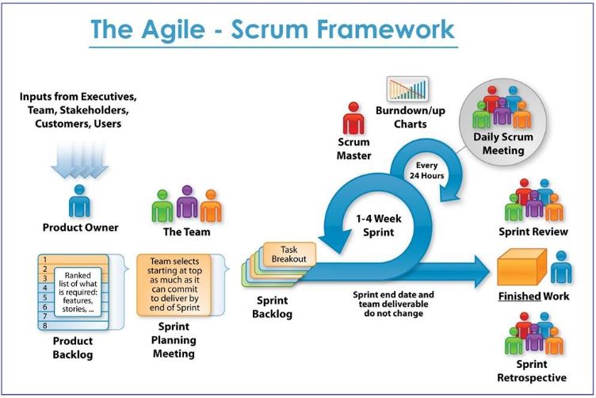

Slide 52
BADS Agile Project Delivery Process Primer
Nancy M. Ketchum, PMP, CSM
Atlanta
nketchum@sei.com
678-557-8155

